Slide 1

ENGL 220 | SPRING 2026 | DR. NAQAA ABBAS
WALKABILITY IN
EDUCATION CITY
Addressing Pedestrian Comfort Through Sustainable Solutions
Team Cocktail
Aazim Rafeeq • Hiba Syed • Kel Doliente • Khaldoun Saadeddine • Youssef Abou Ali
Notes:
ALL MEMBERS: Brief greeting. 'Good morning/afternoon. We are Team Cocktail, and today we'll present our findings on improving walkability in Education City.' (~10 seconds, transition to Aazim)

Slide 2



THE PROBLEM: WALKING IN THE HEAT
40°C+
Why It Matters
Summer temperatures
57%
EC spans 12 km² with 24 tram stations, yet extreme heat and unshaded walkways make walking unbearable.
Increased carbon emissions, reduced physical activity.
Students, faculty members, staff, and visitors are most affected.
Contradicts with QNV 2030 targets
,
Drive private vehicles
17%
Walk between facilities
QNV 2030 targets: 25% emissions reduction • 60–70% pedestrian shade • Sustainable transport
Notes:
MEMBER 1 — AAZIM (~80 seconds): 'Let's start with the problem. Education City was designed as a walkable campus with a 24-station tram system. However, summer temperatures exceed 45°C with humidity of 40-60%, making outdoor walking unbearable. As a result, 57% of the EC population drives private vehicles even for short distances, and only 17% walk. This leads to higher carbon emissions, less physical activity, and weaker community ties. This directly contradicts Qatar's National Vision 2030, which calls for 25% emissions reduction, 60-70% pedestrian shade, and sustainable transport. So addressing walkability isn't just a campus issue — it's a national priority.' Transition: 'Now Hiba will walk us through the first two solutions we evaluated.'

Slide 3

SOLUTIONS EVALUATED (1 OF 2)
1. Park and Plant Initiative
2. Cool Pavement Coatings
Native Sidra & Ghaf trees along walkways to create shaded corridors
• 75% canopy shading optimizes airflow & cooling
• Started with 2,500 trees → target 20,000
• Dubai study: warm/hot hours dropped from 1,291 to <300
• Community programs: 'Adopt a Tree', 'Green Lungs'
Limitation: 3-5 years to full canopy maturity
Reflective layers on walkways to reduce heat absorption
• Surface temps reduced by 2.6–4.9°C
• Low cost, minimal construction required
• Easy campus-wide application
Limitation: May increase radiant temperature at pedestrian level by 2–3°C, making walkers feel hotter. Degrades with UV/dust.
Notes:
MEMBER 2 — HIBA (~80 seconds): 'We evaluated four solutions in two categories: nature-based and engineered cooling. First, the Park and Plant initiative — this is Qatar Foundation's existing tree-planting program using native Sidra and Ghaf trees. Research shows 75% canopy coverage provides optimal airflow and cooling. A Dubai university study found that similar planting reduced warm/hot hours by over 75%. The program has community backing through Adopt a Tree and Green Lungs. The main limitation is that trees need 3-5 years to mature. Second, cool pavement coatings — reflective layers that lower surface temperatures by up to 5°C. They're cheap and easy to apply, but here's the catch: they can actually increase the heat walkers feel at body level by 2-3°C, and they degrade over time.' Transition: 'Kel will now cover the remaining two solutions.'

Slide 4


SOLUTIONS EVALUATED (2 OF 2)
3. Enclosed Walkways
4. Solar-Powered Misting
Air-conditioned enclosed corridors for full climate control
• Best thermal comfort of all solutions
• Qatar precedents: Industrial Area bridge, Mall of Qatar connection
• Protects vulnerable groups (children, elderly)
Limitation: Massive energy demands contradict sustainability goals. High cost, impractical for EC's spread-out layout. Reduces open social spaces.
High-pressure misting nozzles powered by solar panels
• Shade + misting reduces thermal index by 12.3°C
• Proven at Expo 2020 Dubai & Saudi Arabia
• Smart sensors activate only when needed
Limitation: Effectiveness drops at humidity >60-70%. Qatar's summer humidity reaches 40-60%. Limited to existing canopy areas. Nozzle maintenance issues.
Notes:
MEMBER 3 — KEL (~80 seconds): 'The third solution is climate-controlled enclosed walkways — essentially air-conditioned corridors. These offer the best thermal comfort and Qatar already has examples like the Mall of Qatar pedestrian bridge. However, the energy demands are enormous and directly contradict sustainability goals. EC's spread-out layout makes campus-wide enclosure impractical and extremely expensive. Fourth, solar-powered misting systems — nozzles that spray fine mist to cool the air, powered by solar panels. Research shows shade plus misting can reduce the thermal index by over 12°C. But there's a critical issue: misting loses effectiveness when humidity exceeds 60-70%, and Qatar's summers already reach 40-60% humidity. Coverage is also limited to existing canopy areas.' Transition: 'Khaldoun will now present how we compared these solutions.'

Slide 5


WEIGHTED DECISION MATRIX
Criteria | Weight | Park & Plant | Cool Pavement | Enclosed Walkways | Solar Misting | EC Canopies (Reference)
Thermal Comfort | 30% | 3 (0.90) | 1 (0.30) | 5 (1.50) | 4 (1.20) | 3 (0.90)
Sustainability | 30% | 5 (1.50) | 2 (0.60) | 1 (0.30) | 4 (1.20) | 3 (0.90)
Coverage & Scalability | 25% | 4 (1.00) | 5 (1.25) | 2 (0.50) | 3 (0.75) | 3 (0.75)
Feasibility | 15% | 4 (0.60) | 4 (0.60) | 1 (0.15) | 3 (0.45) | 3 (0.45)
TOTAL SCORE |  | 4.00 | 2.75 | 2.45 | 3.60 | 3.00
Park and Plant scores highest (4.00/5.0) — the most balanced and context-appropriate solution
Notes:
MEMBER 4 — KHALDOUN (~80 seconds): 'To compare solutions objectively, we used a weighted decision matrix with four criteria aligned to QNV 2030. Thermal comfort and sustainability each received 30% weight as the most critical factors. Coverage and scalability got 25%, and feasibility 15%. As you can see, Park and Plant scored the highest at 4.00 out of 5. It scored 5 in sustainability — trees sequester carbon and improve biodiversity. It scored 4 in both coverage and feasibility since the program is already operational with established budgets. Solar misting came second at 3.60, strong in thermal comfort but limited by humidity issues. Enclosed walkways scored lowest at 2.45 — great thermal comfort but terrible sustainability and feasibility. The matrix clearly shows Park and Plant as the most balanced solution.' Transition: 'Finally, Youssef will present our recommendation and implementation plan.'

Slide 6




RECOMMENDATION: EXPAND PARK AND PLANT
Already Operational
Implementation Phases
Existing QF program with staffing, budgets, and 2,500+ trees planted
1
Phase 1 (Years 1–2)
High-traffic corridors linking tram stations to key buildings
Eco-Friendly
Sequesters carbon, cleans air, improves biodiversity
2
Phase 2 (Years 2–4)
Expand to housing, parking areas, and Oxygen Park
Compounding Impact
Shade and cooling grow stronger every year as trees mature
3
Phase 3 (Years 4–6)
Achieve 60–70% campus-wide shade coverage
Climate-Proof
Effective in any humidity — unlike misting systems
Aligns with QNV 2030: Environmental sustainability, human development, and 60–70% shade target
Notes:
MEMBER 5 — YOUSSEF (~80 seconds): 'Based on our analysis, we recommend expanding Qatar Foundation's Park and Plant initiative. Here's why it stands out: First, it's already operational — no new programs need to be created. QF has staffing, budgets, and community engagement in place. Second, it's the most sustainable option — trees sequester carbon, clean the air, and provide compounding benefits as they grow. Third, unlike misting, it works in any humidity level. Our implementation plan has three phases: start with high-traffic corridors near tram stations, then expand to housing and parking areas, and finally achieve the national target of 60-70% shade coverage by year 6. This directly aligns with Qatar National Vision 2030's pillars of environmental sustainability and human development. The main limitation is time to maturity — but existing canopy structures provide interim shade during the growth period. Thank you — we welcome your questions.'

Slide 7
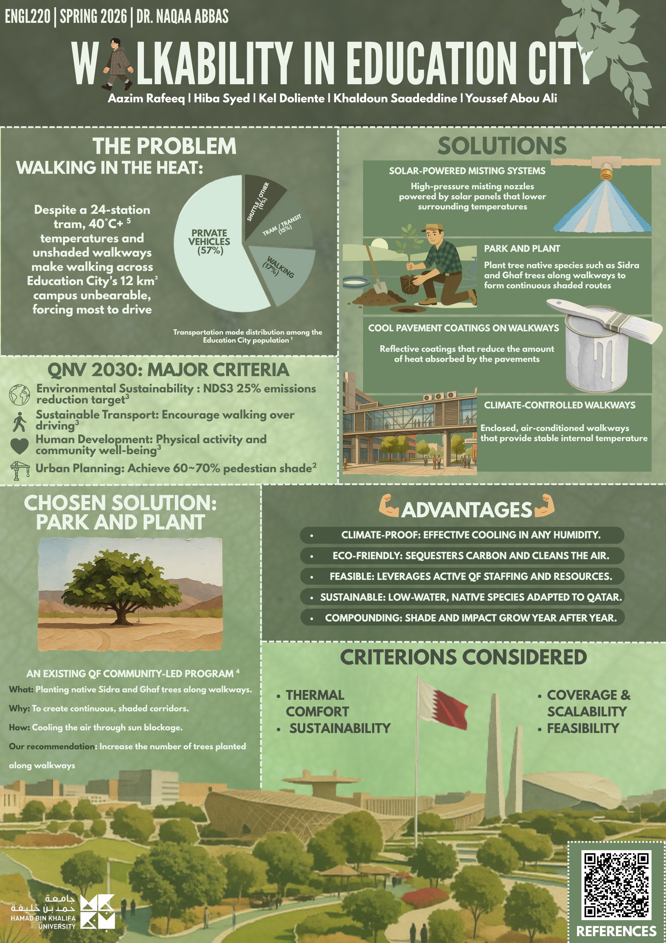
OUR RESEARCH POSTER

Slide 8
THANK YOU
Questions?
Team Cocktail • ENGL 220 • Spring 2026
Notes:
ALL MEMBERS: Stand together for Q&A. Any member should be ready to answer any question about any part of the presentation.

